Slide 1

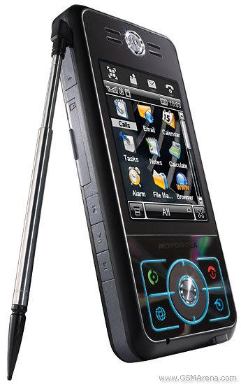
نأمل من الحضور الكرام إقفال هواتفهم النقالة.

Slide 2

;
UNIVERSITY OF BENGHAZI
FACULTY OF ENGINEERING
INDUSTRIAL AND MANUFACTURING SYSTEMS ENGINEERING DEPARTEMENT
IMPROVING LAYOUT EFFECTIVENESS THE ROLE INCREASING CUSTOMER SATISFACTION
B.Sc. Project
By
NAIMA ALKWAFAI 14902
DALAL ALAWSHARA 13539
ASMAA ELGHMAI 13449
NAJAAT ESHGAIFA 15203
MONERAH MOSTAFH 15200
Supervisor: Dr. Omar Gnaiber.

Slide 3
  CHAPTER 1
  INTRODUCTION
  CHAPTER 2
  LAYOUT AND FLOW
  CHAPTER 3
  SELECTED CASE STUDY EVALUATION AND ANALYSIS
  CHAPTER 4
CONCLUSION AND RECOMMENDTIONS
CONTENT

Slide 4
1
INTRODUCTION
2
3
CASE STUDY AND ANALYSIS.
4
CONCLUSION AND RECOMMENDATIONS
LAYOUT AND FLOW.
5
OUR VISION AS INDUSTRIAL ENGINEERS

Slide 5
THE REPORT OBJECTIVES
The current report would be applied to achieve the following objectives:
Study the different Layouts types.
Be acquainted with the needed considerations while establishing effective layout.
Be able, as industrial engineers, to apply the theoretical concerns of effective layout.
Depict as much as we can, how to apply the theoretical side on a selected local organization.
Show how important such techniques in increasing customers satisfaction.

Slide 6
1
INTRODUCTION
2
3
CASE STUDY AND ANALYSIS.
4
CONCLUSION AND RECOMMENDATIONS
LAYOUT AND FLOW.
5
OUR VISION AS INDUSTRIAL ENGINEERS

Slide 7
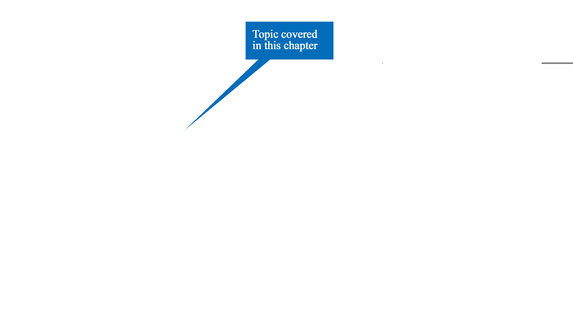
WHERE ARE WE ON THE ROAD MAP ?
?

Slide 8
LAYOUT AND FLOW – DEFINITIONS
  Layout :
  Deciding where to put all the facilities ,machines ,equipment and staff in an operation.
  Flow :
    The way in which transformed resources travel through the operation.

Slide 9
The basic layout types
Fixed position layout
Cell layout
Function layout
Process layout

Slide 10
    1) FIXED POSITION LAYOUT
Raw material
Finished Product
(Aircraft)
Machines & Equipments
Labor

Slide 11
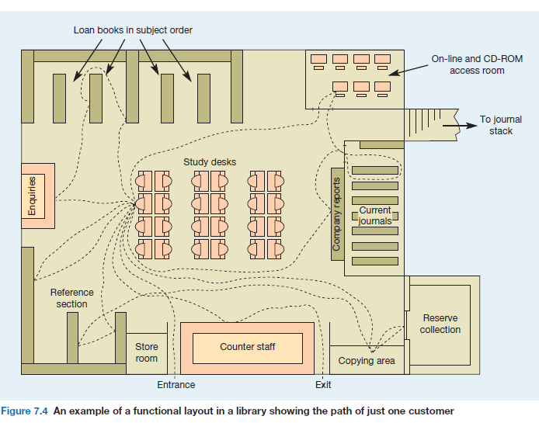
2) FUNCTIONAL LAYOUT

Slide 12

4) CELL LAYOUT

Slide 13
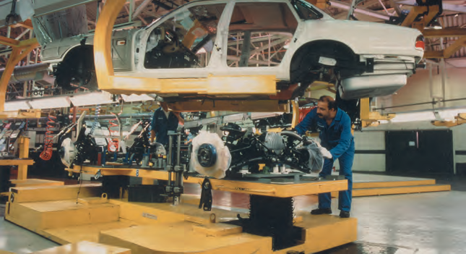
3) PROCESS LAYOUT

Slide 14
MIXED LAYOUT

Slide 15
volume and cost
The volume–variety
select Method the types of layout
Manufacturing process types and Service process types

Slide 16
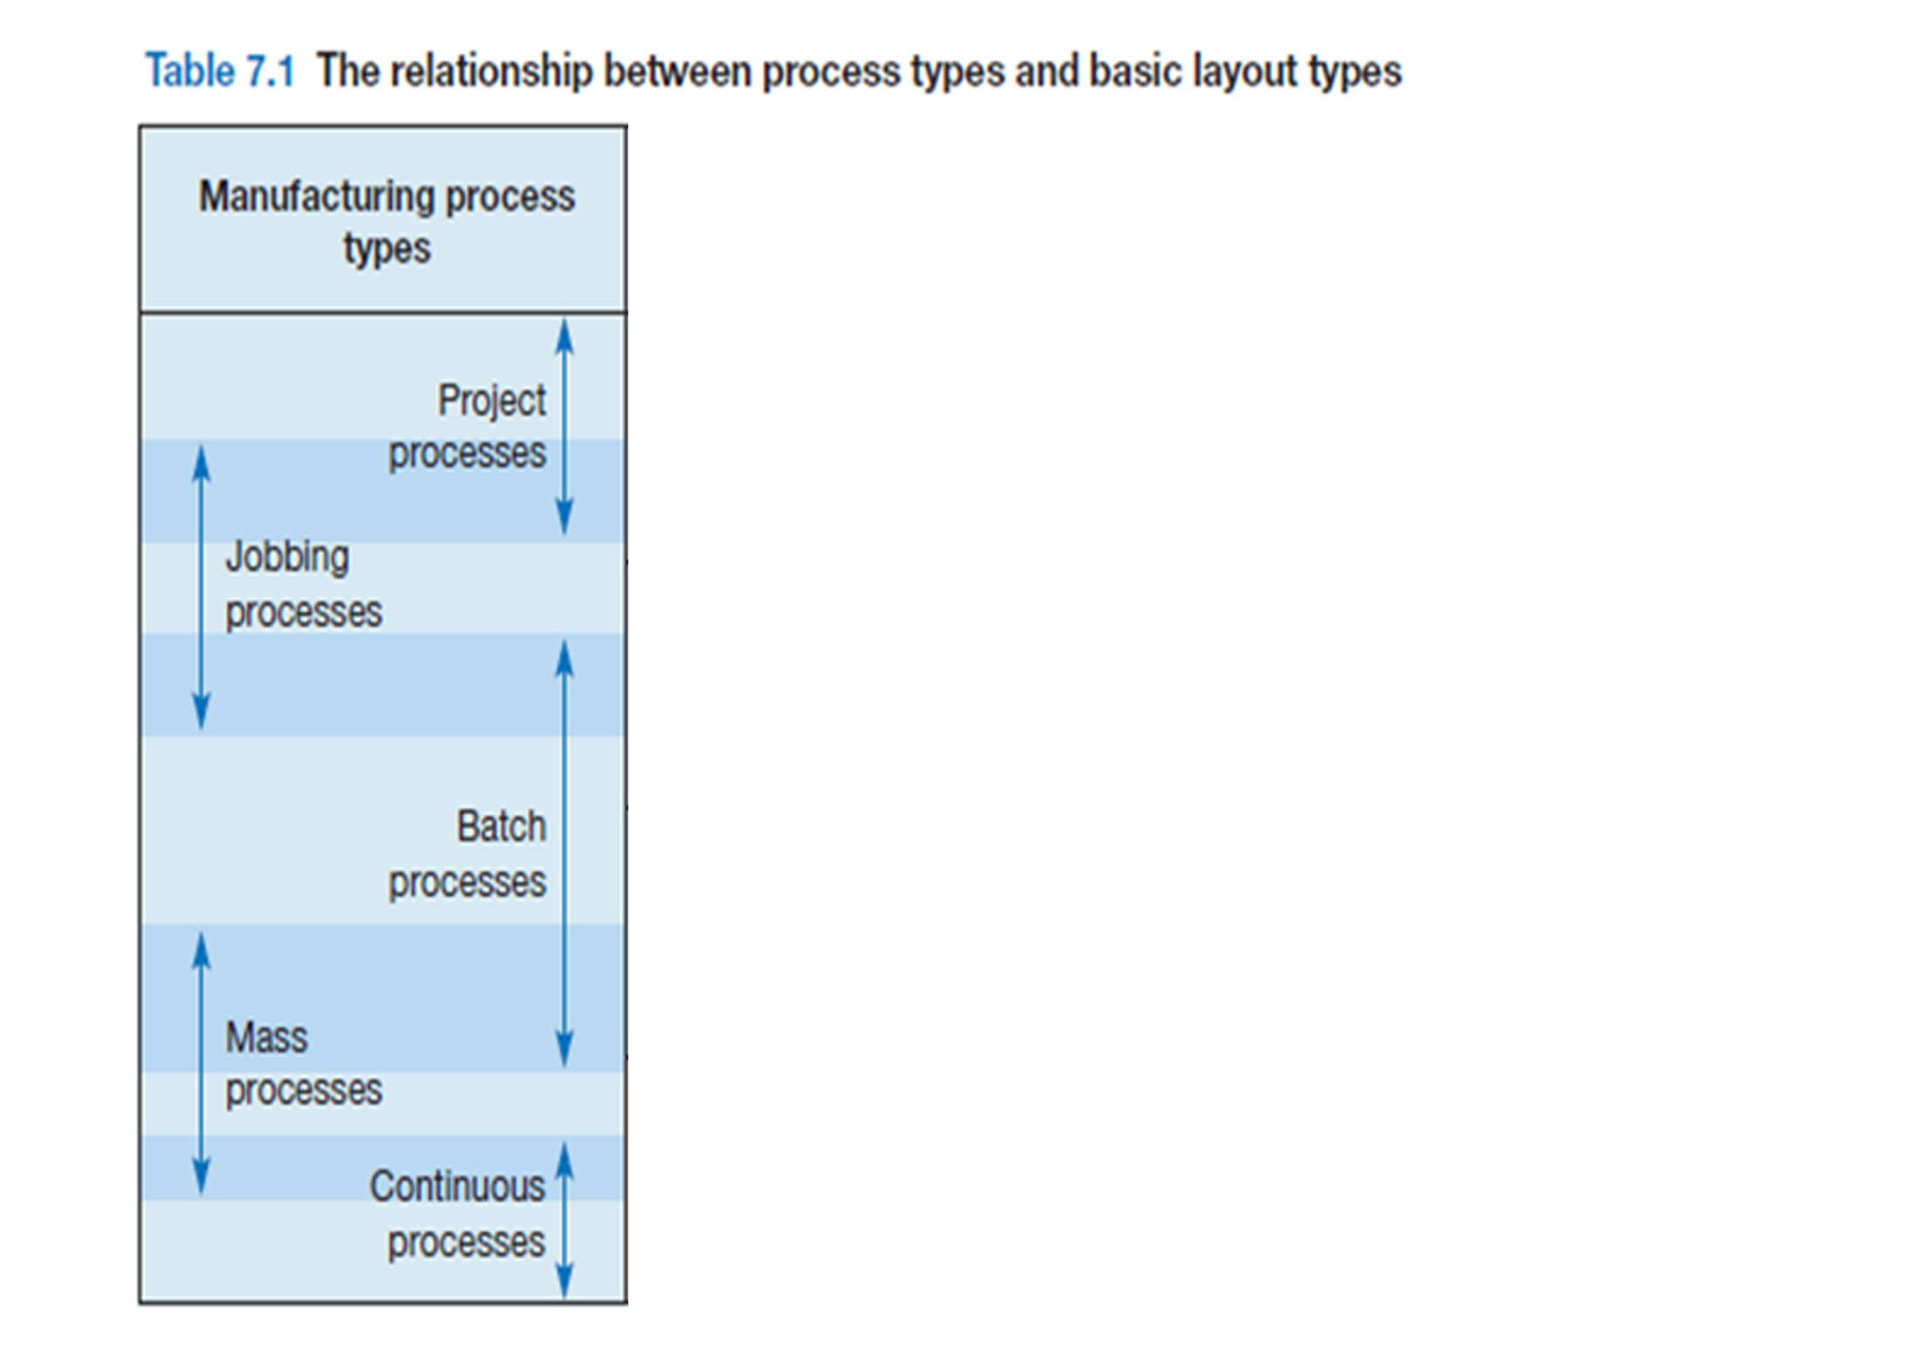
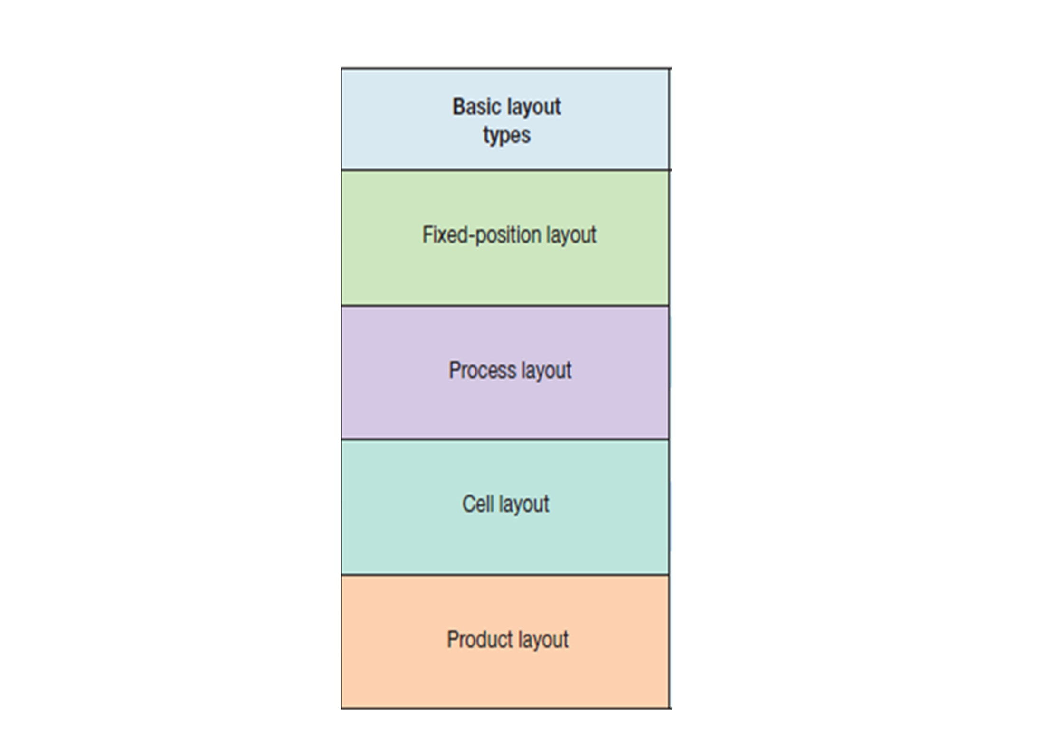
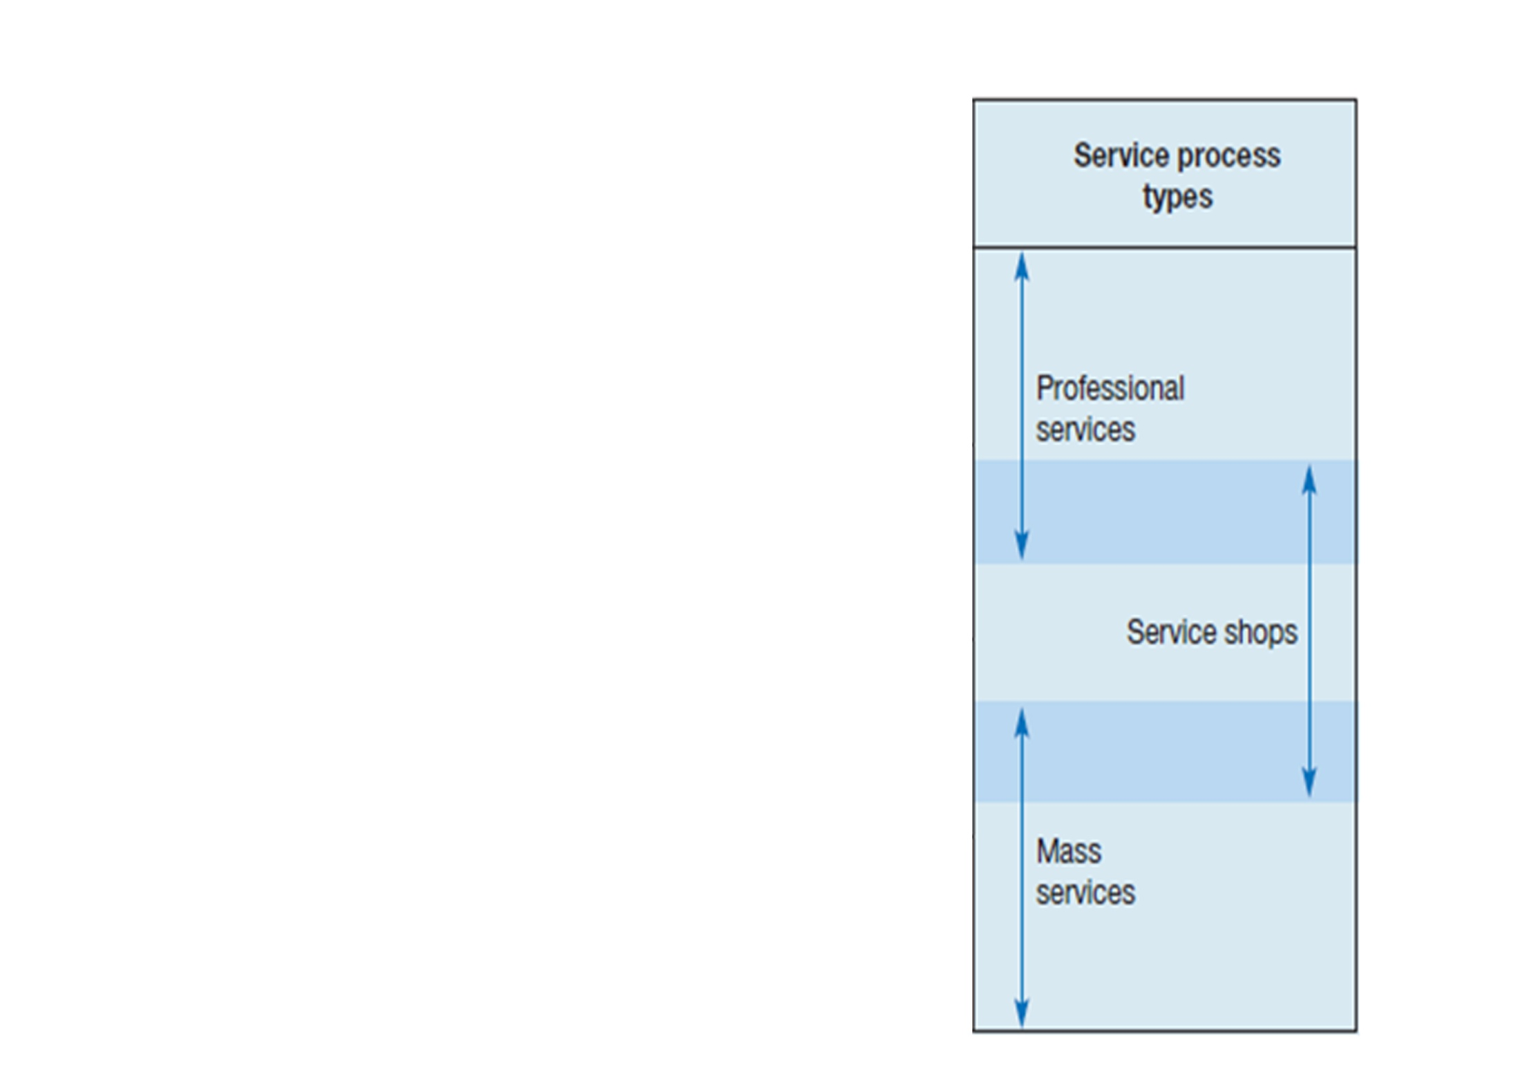

Slide 17
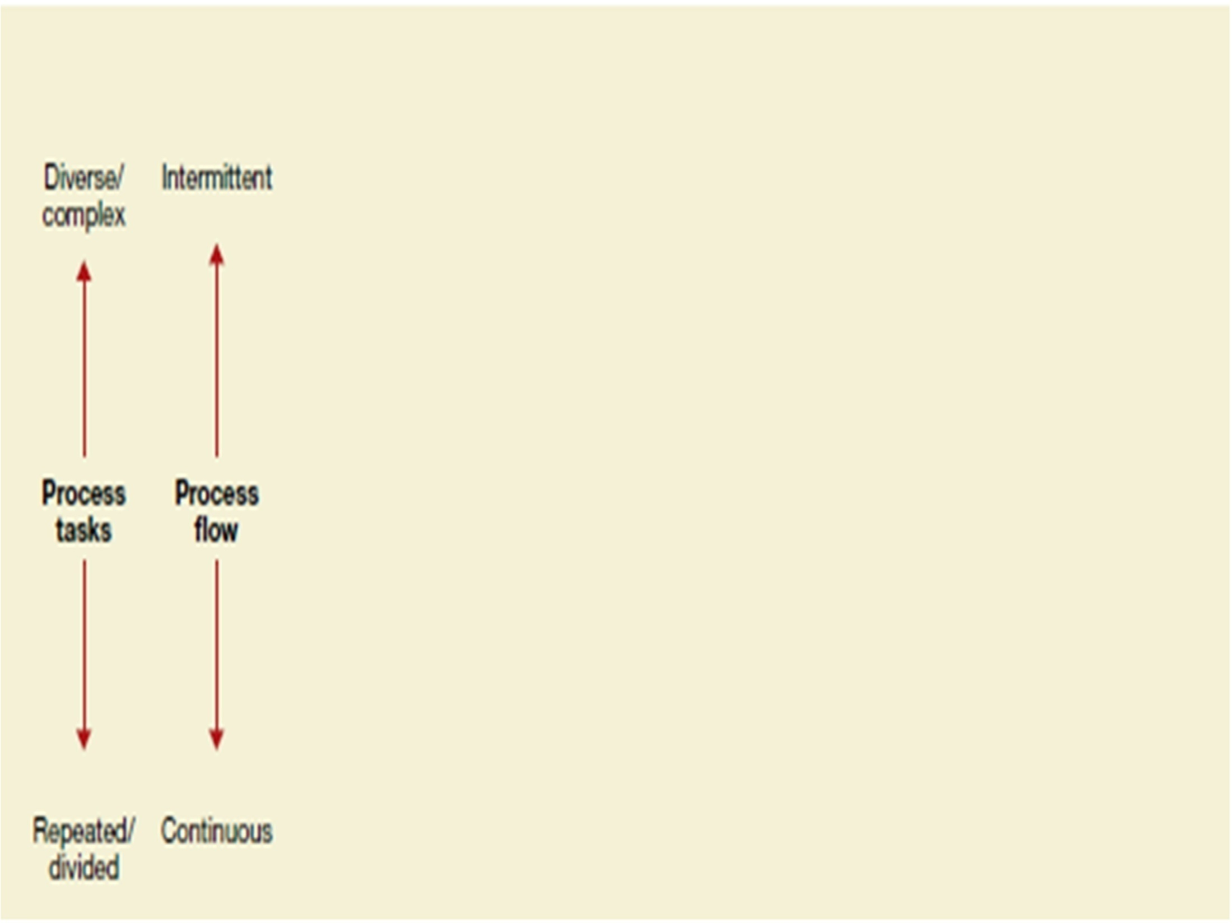
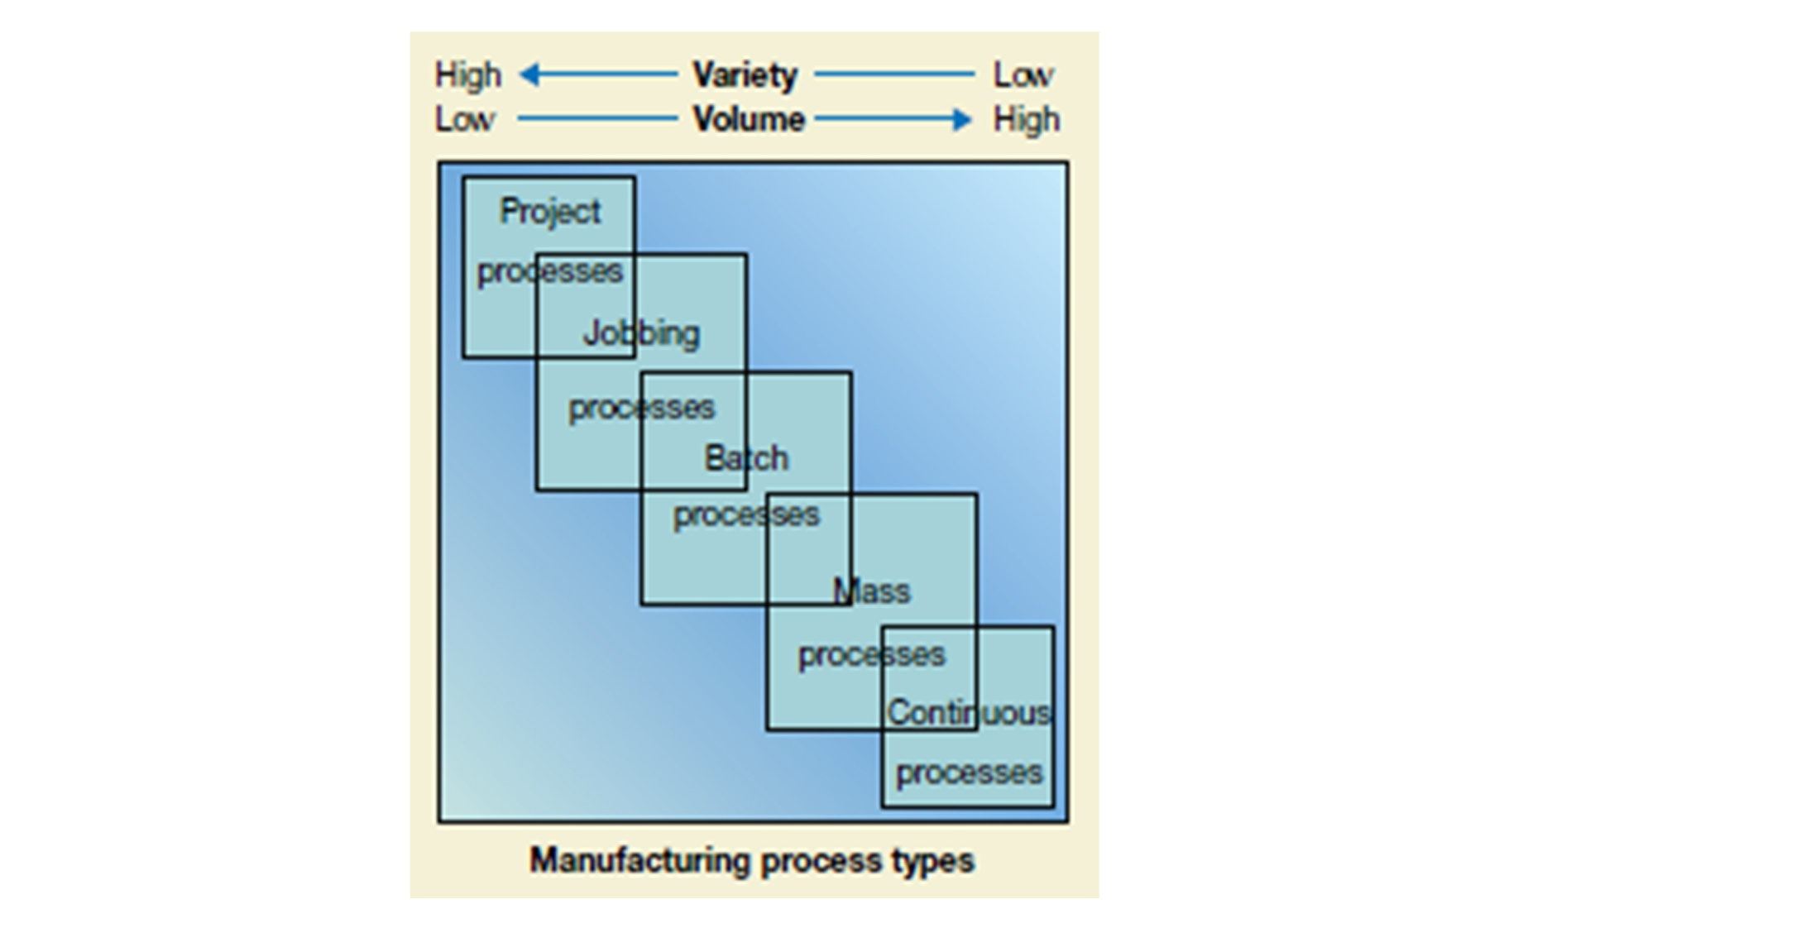
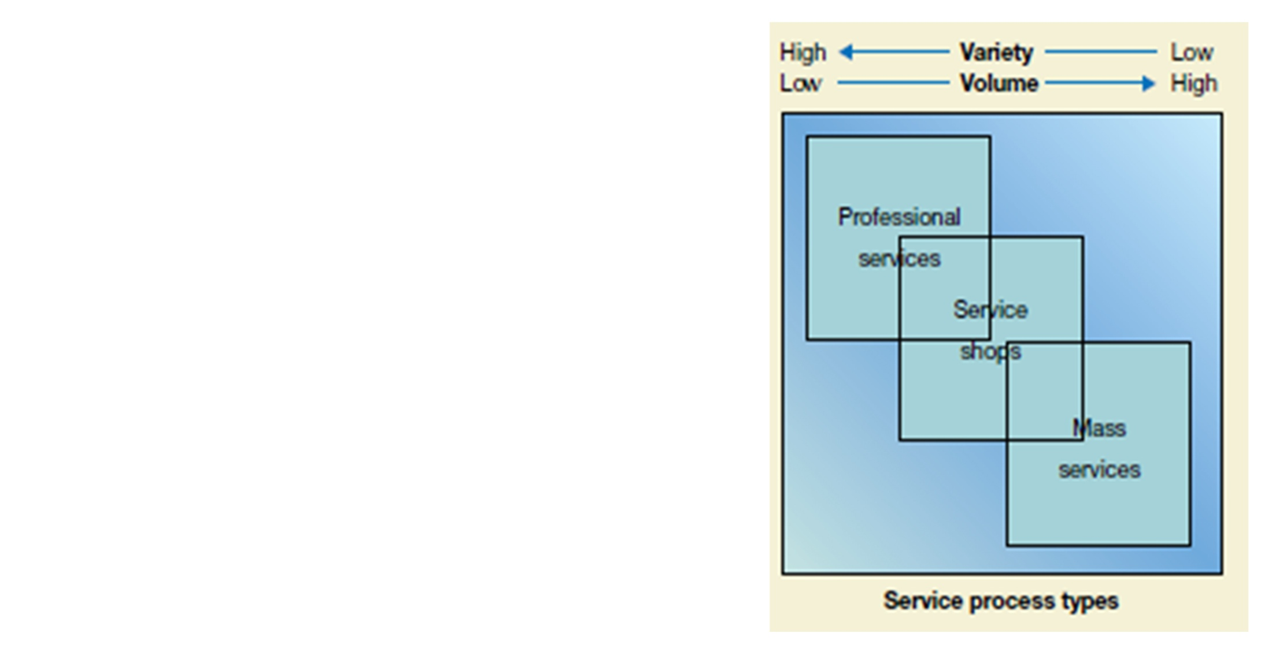
VOLUME - VARIETY & LAYOUT TYPE

Slide 18
1
INTRODUCTION
2
3
CASE STUDY AND ANALYSIS.
4
CONCLUSION AND RECOMMENDATIONS
LAYOUT AND FLOW.
5
OUR VISION AS INDUSTRIAL ENGINEERS

Slide 19
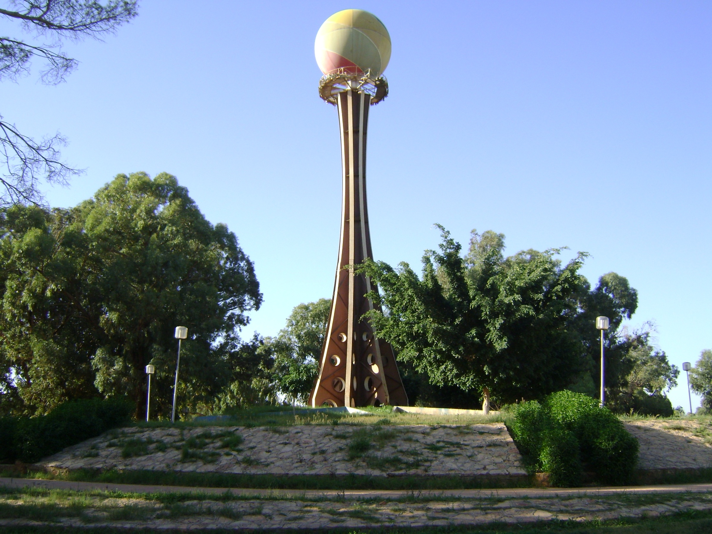
CASE STUDY AND ANALYSIS.

Slide 20
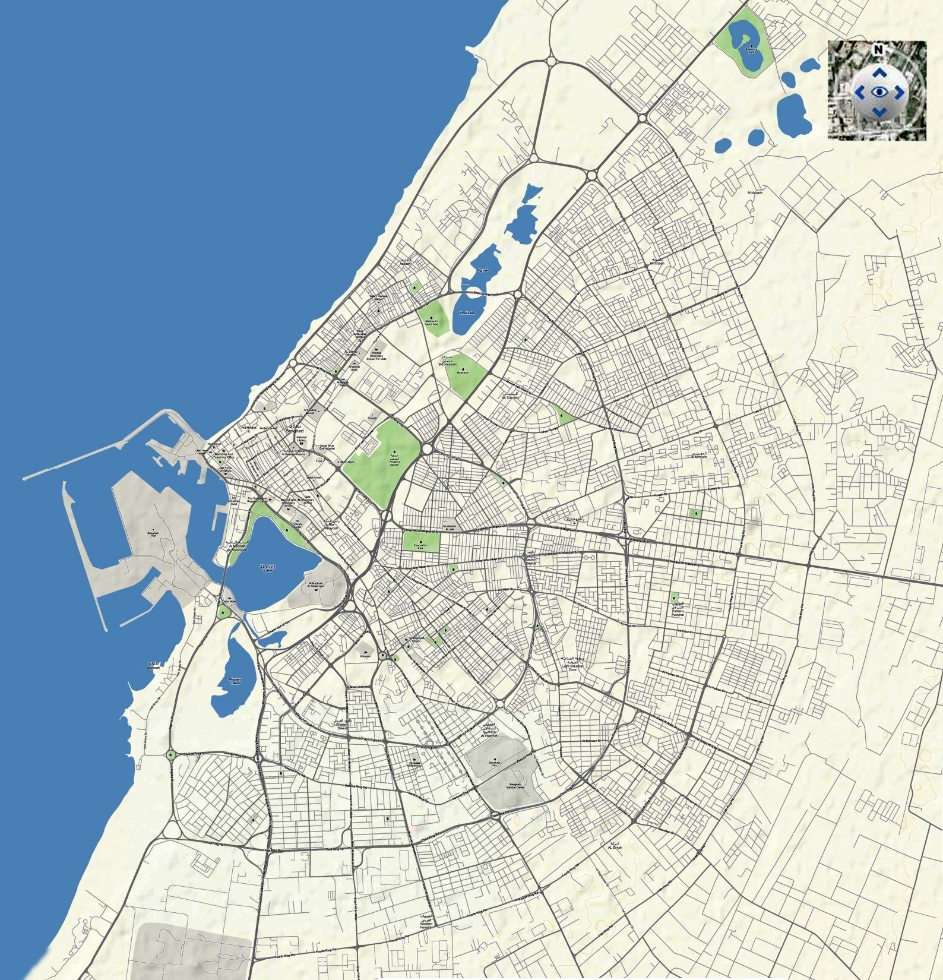
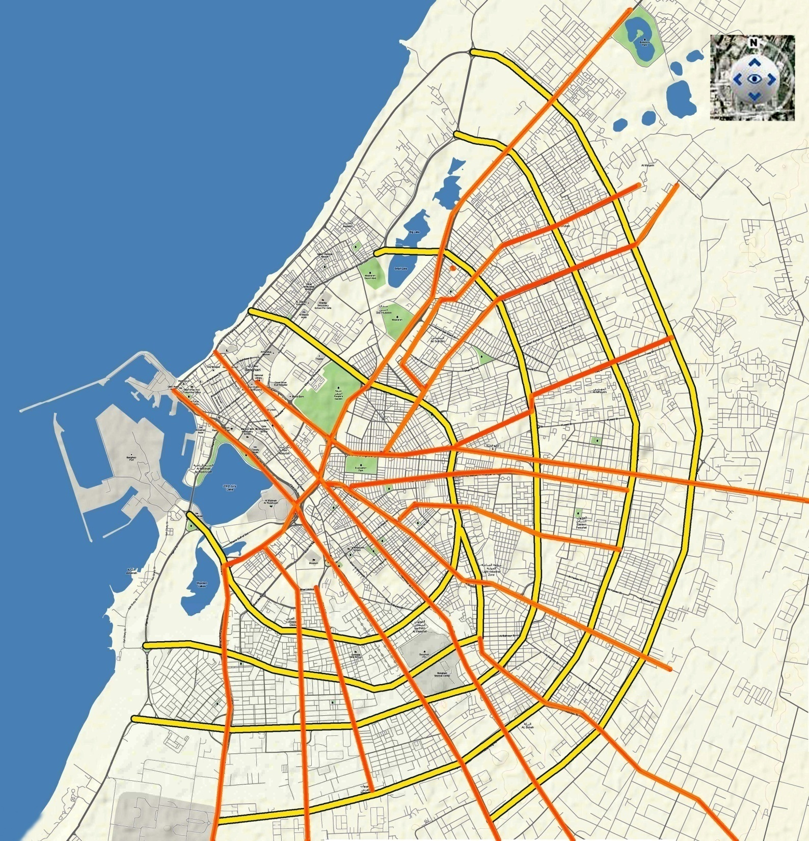
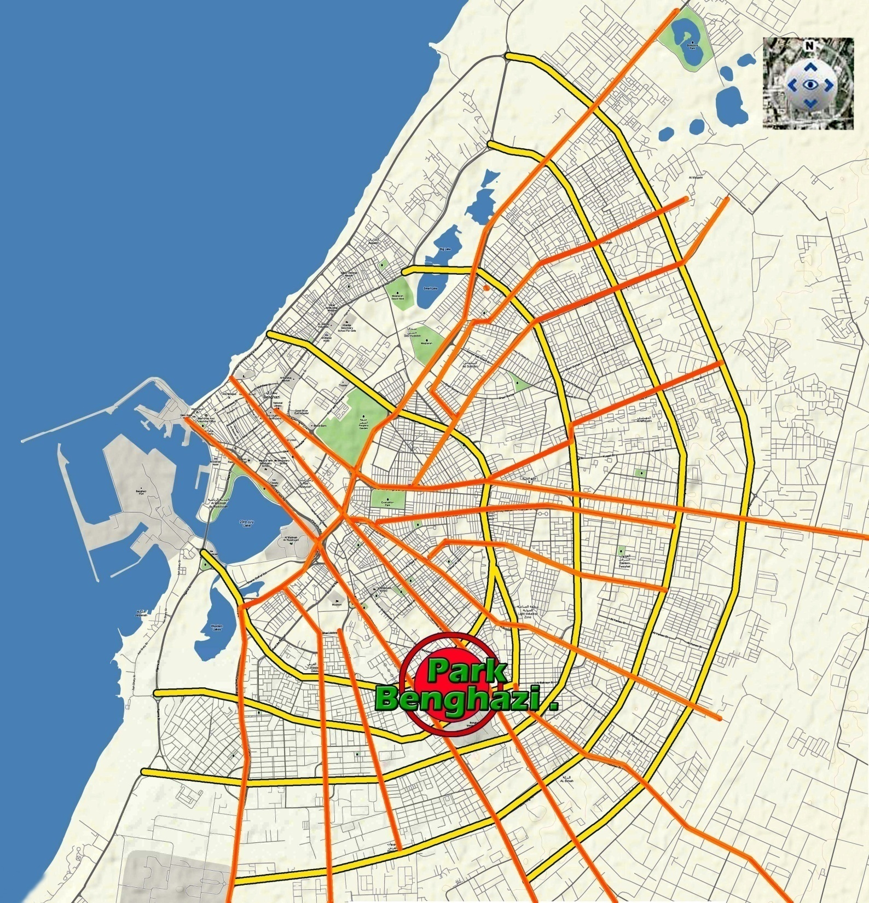
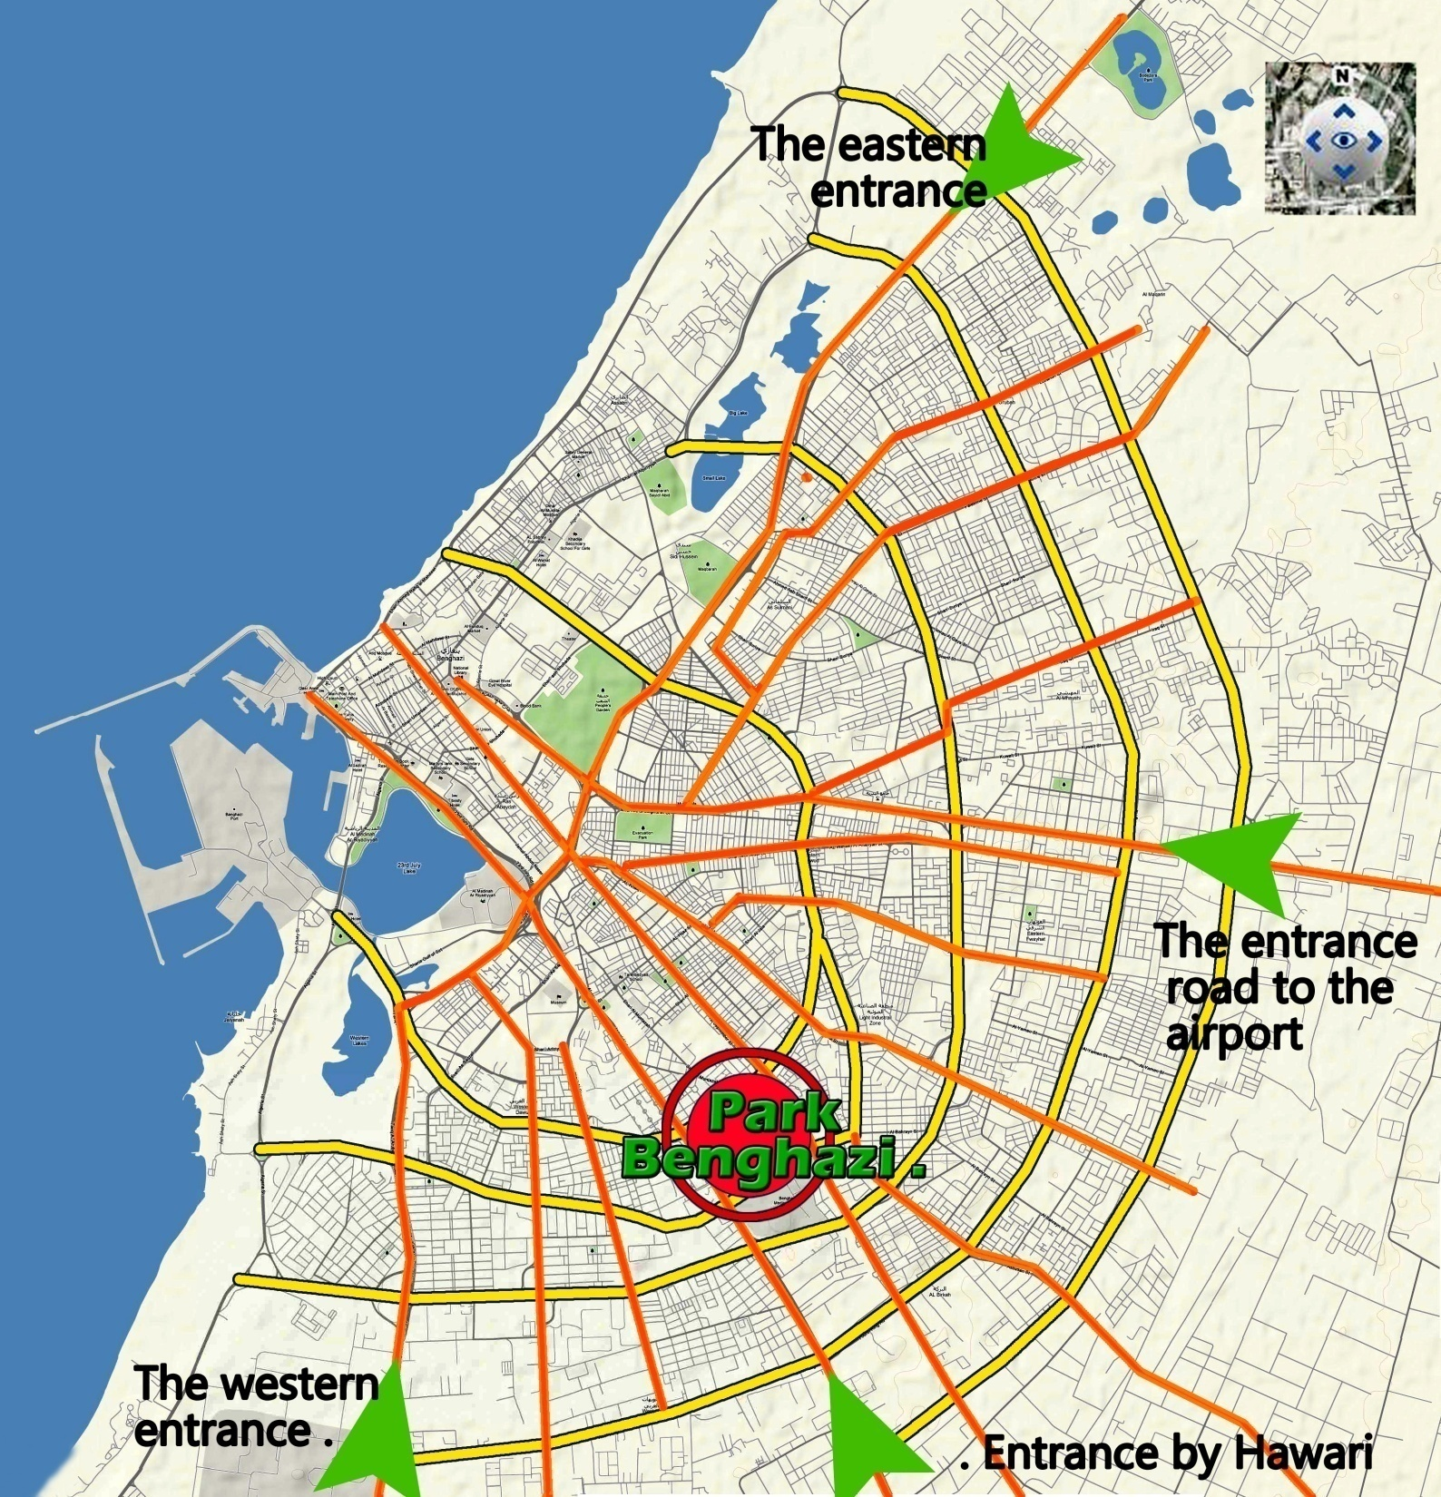
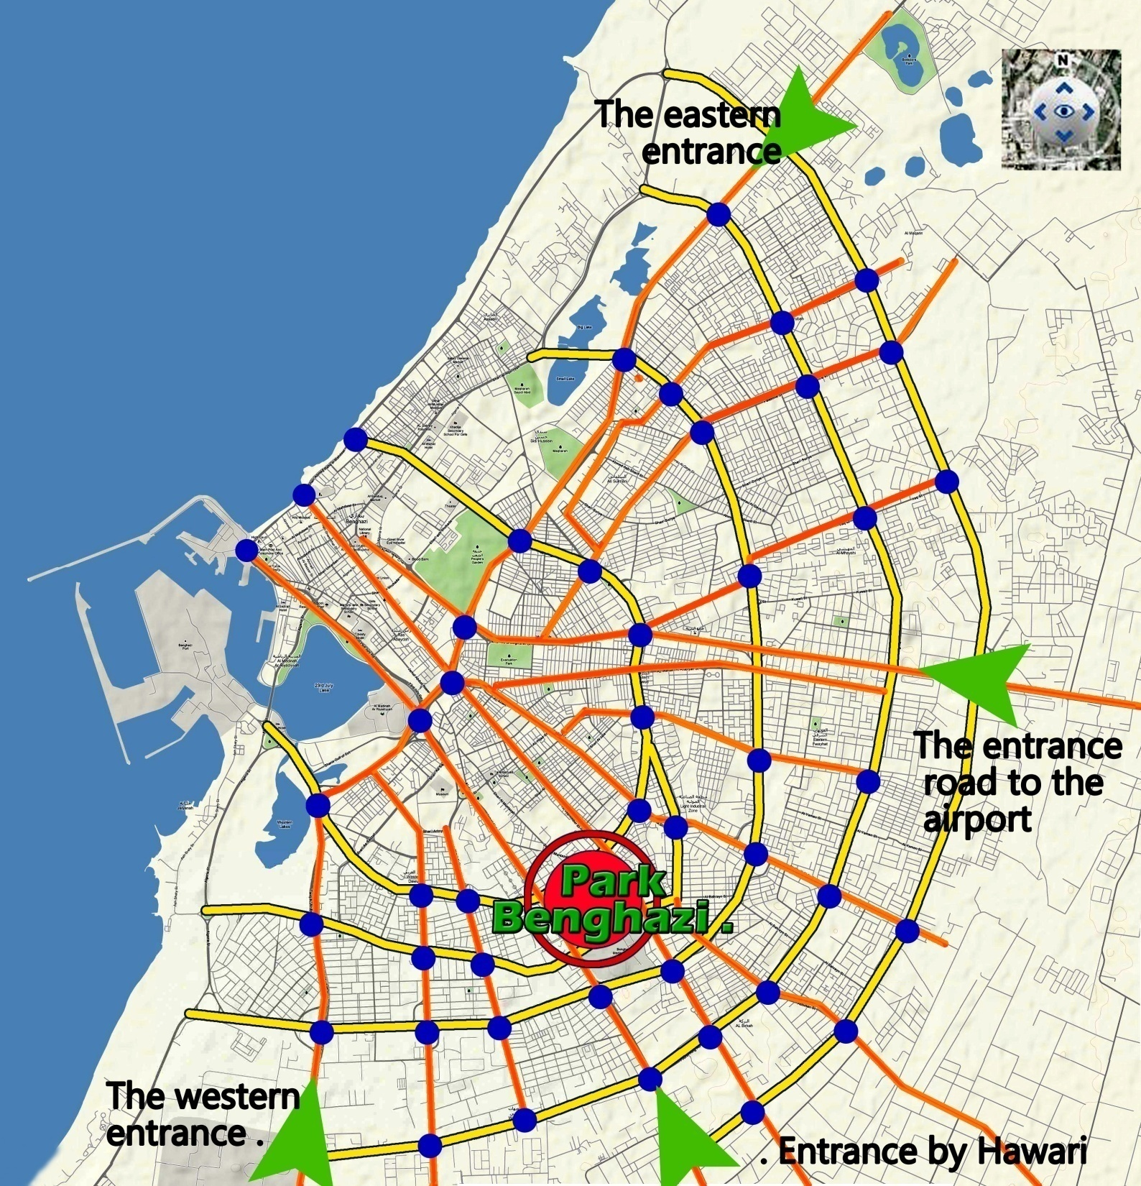
OVER ALL LOCATION.

Slide 21
FACTS AND EVALUATION
THE KEY ELIMENTS OF THE PARK
1) Location.
2) Games area.
3) The zoo.
4) Service centers.
5) Devious actives.

Slide 22
ANALYSIS OF THE CURRENT SITUATION
The park operation capacity can be illustrated as follows:
The maximum capacity to operate is (24000 visitor/day) like in holidays.
The medium capacity to operate is (12000 visitor/day) like in Fridays.
The lower capacity to operate is (6000 visitor/day) like in regular days.
.

Slide 23
ANALYSIS OF THE CURRENT SITUATION
THE RUSH HOURS ARE:
2) Spring time and school trips.
3) Formal holidays and Fridays
1) The holidays.

Slide 24
ANALYSIS OF THE CURRENT SITUATION
THESLOW HOURS ARE:
3) Regular days of the weeks.
1) Winter season
2) Simmer season.

Slide 25
EVALUATION THE VIEWS OF VISITORS THROUGH THE FACT
EXAMPLES OF QUESTIONS:

Slide 26
Display The Results Of The Questionnaire

Slide 28
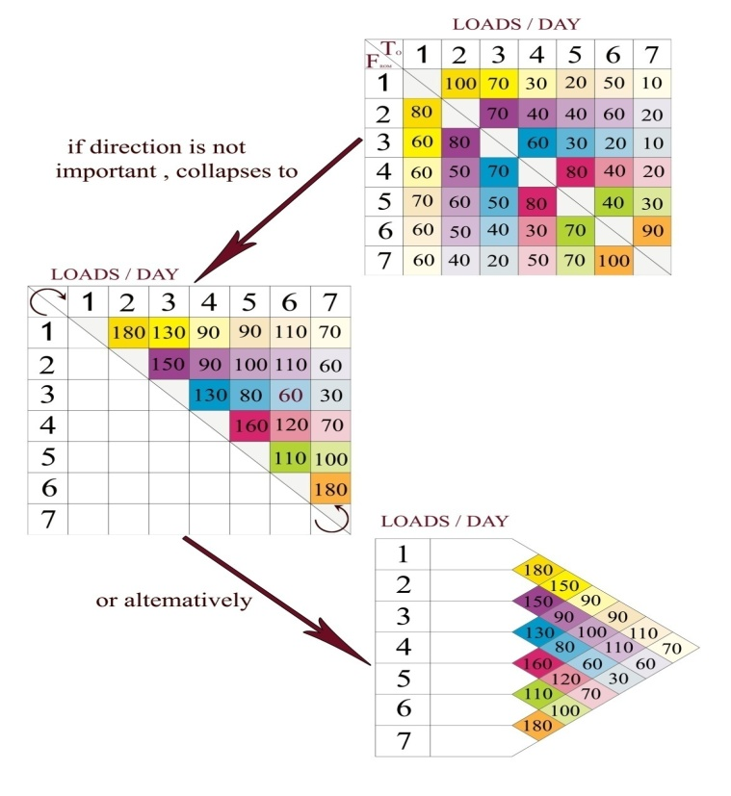
DETAILED DESIGN OF THE LAYOUT
Step1: information collection relating to the work centers and the flow between them are shown in the flow chart

Slide 29
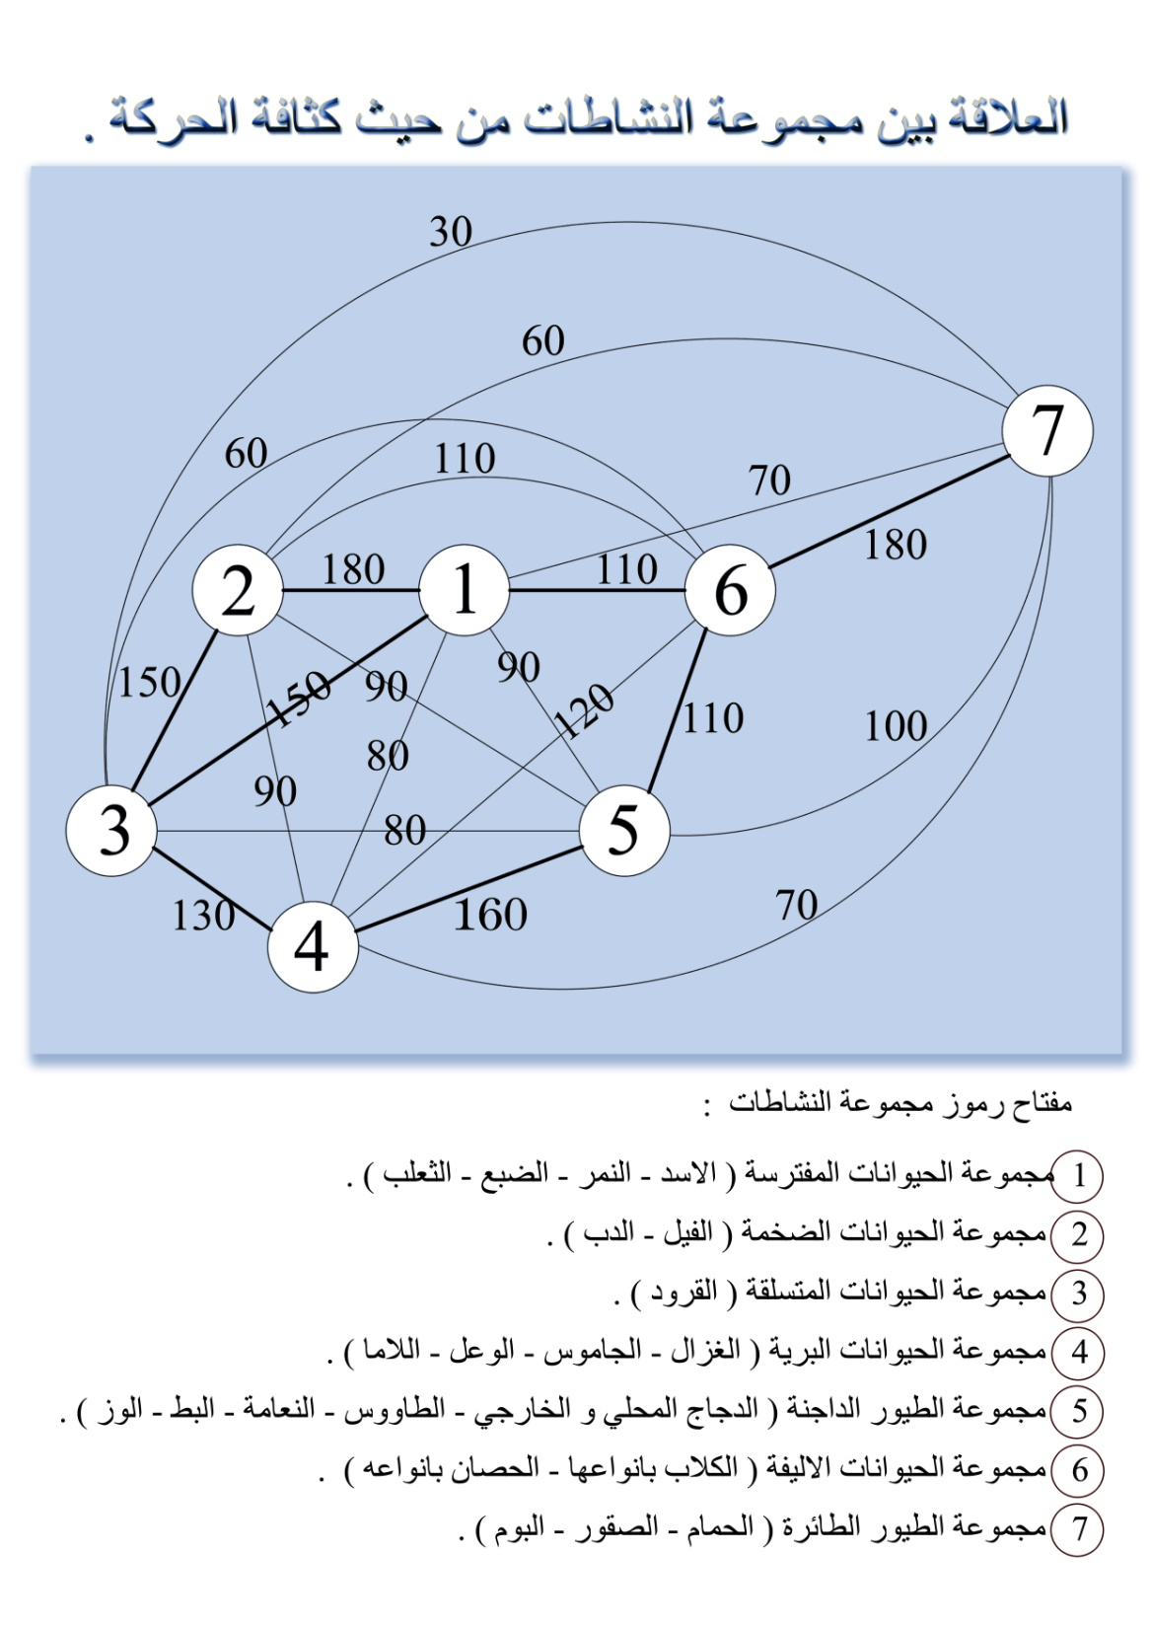
DETAILED DESIGN OF THE LAYOUT
Step2: drawing up a schematic layout showing the work centers and the flow between them , putting the work centers with the greatest flow closest to each other are shown in Fig.

Slide 30
DETAILED DESIGN OF THE LAYOUT
Step 3: adjust the schematic layout to take into account the constraints of the area in to which the layout must fit.
Step 4: drawing up the layout showing the actual work center areas and loads between activities .

Slide 31
DETAILED DESIGN OF THE LAYOUT
Bird group of animals
Bird group of animals
Bird group of animals
Step 5: check to see whether exchanging any two work centers will reduce the total distance travelled.
GROUP A PET
GROUP LARGE ANIMALS
GROUP PREDATOR
BIRD GROUP OF ANIMALS
CLIMBING GROUP OF ANIMALS
GROUP OF WILD ANIMALS
GROUP DOMESTIC ANIMALS

Slide 32
Animals
Group large animals
Bird group of animals
Group predators
Group
a pets
Climbing group of animals
Group domestic animals
Group of wild

Slide 33
1
INTRODUCTION
2
3
CASE STUDY AND ANALYSIS.
4
CONCLUSION AND RECOMMENDATIONS
LAYOUT AND FLOW.
5
OUR VISION AS INDUSTRIAL ENGINEERS

Slide 34
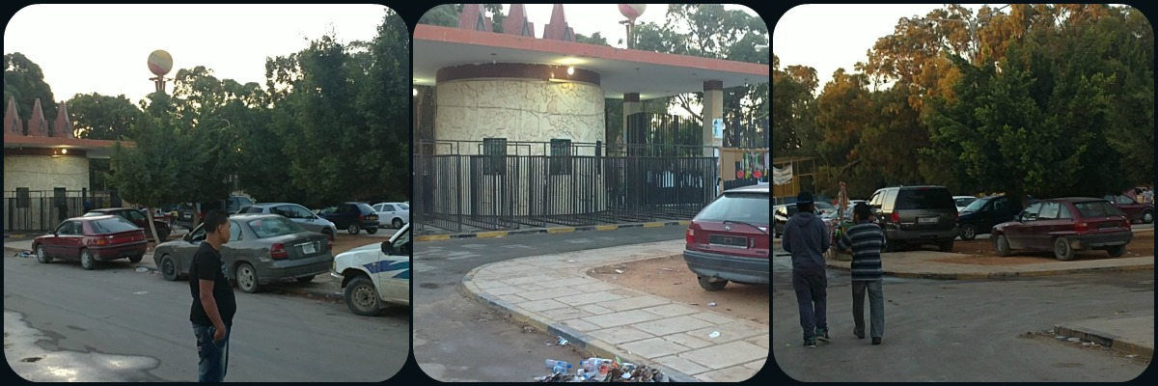
CONCLUSION
1) Parking:

Slide 35
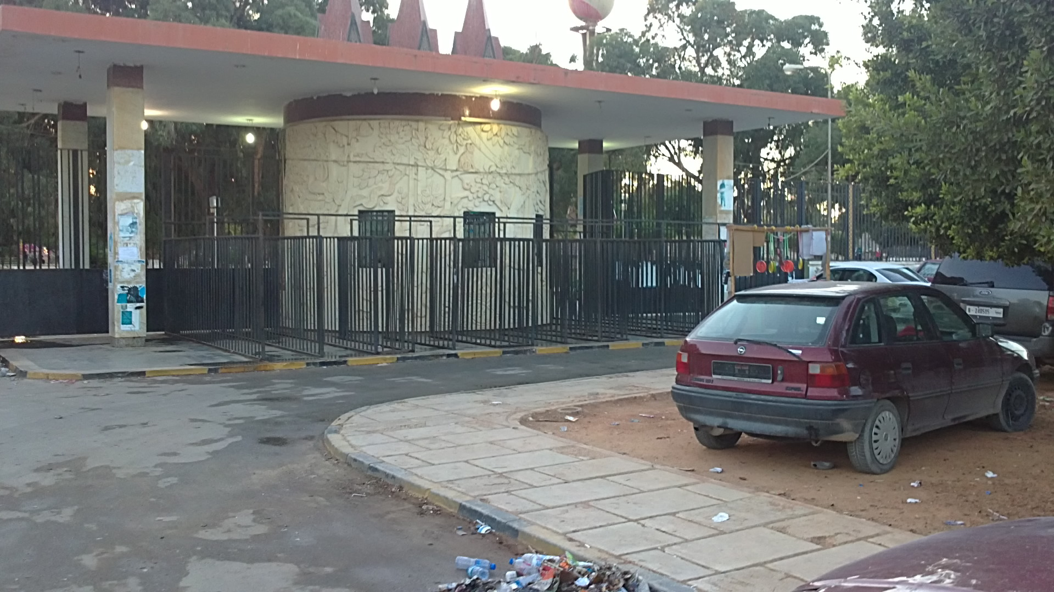
2) Park Entrance:

Slide 36
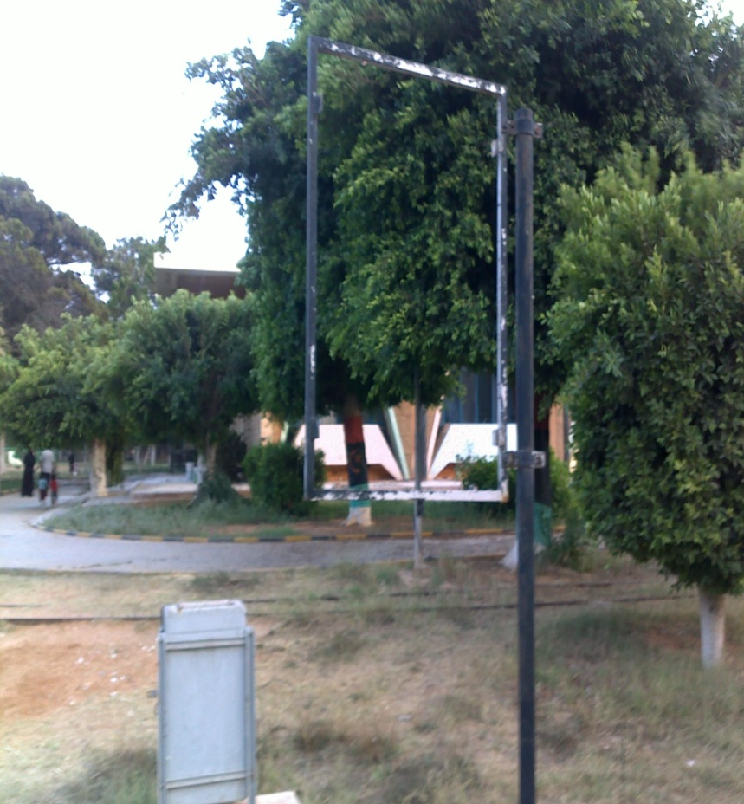
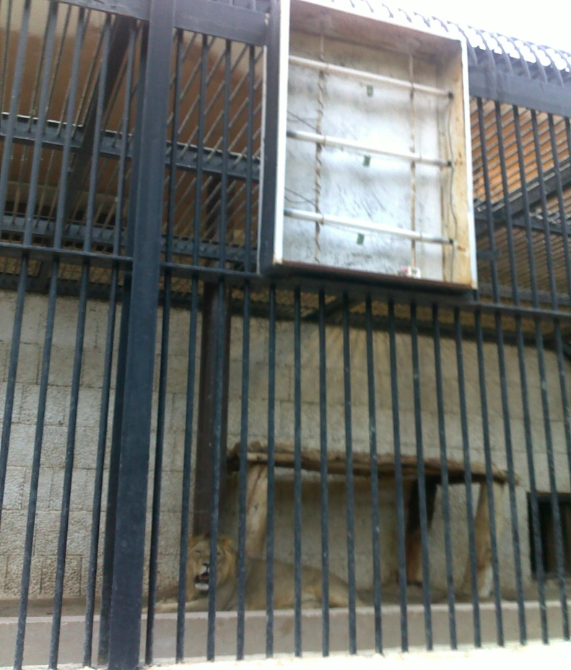
3)Indicative Signals:

Slide 37
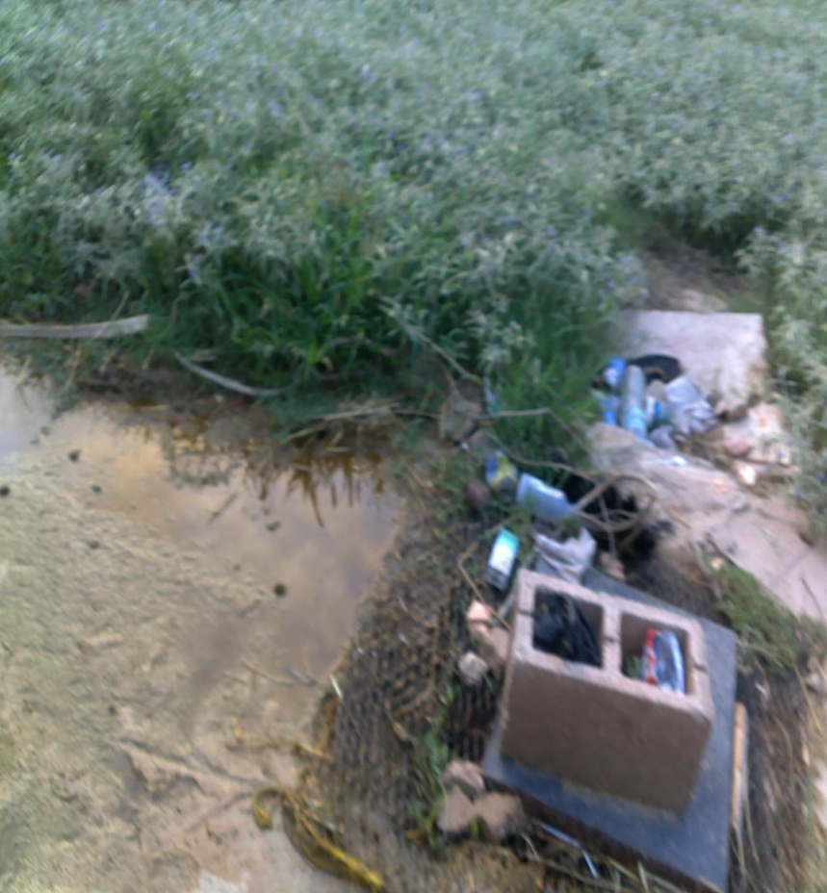
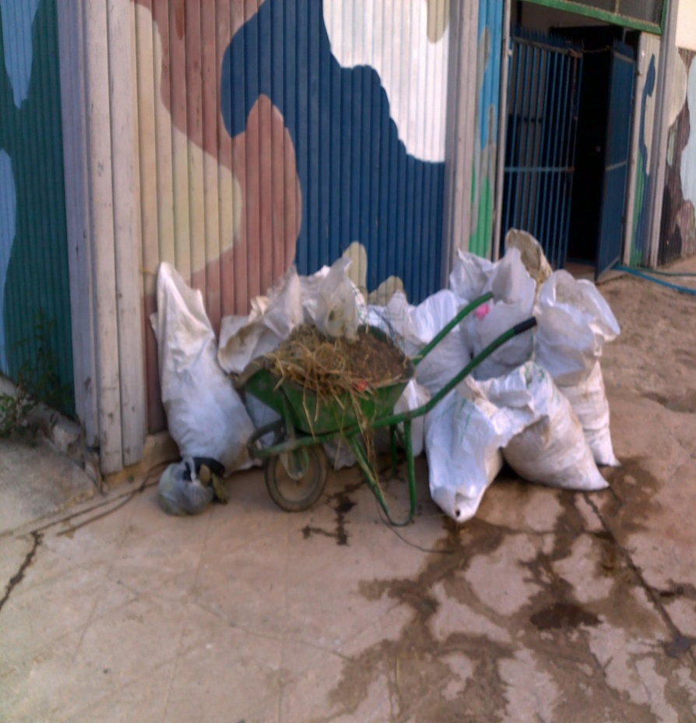
4) Team work :-

Slide 38
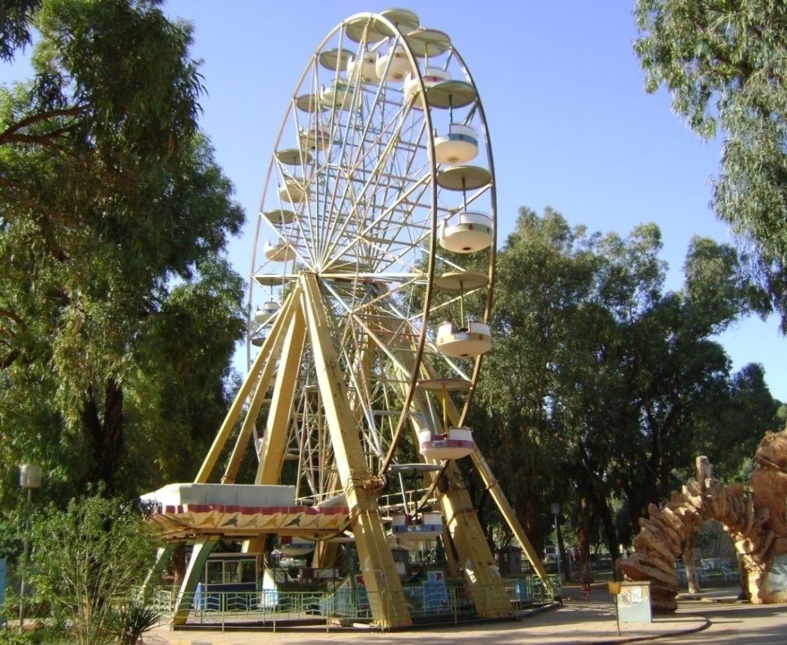
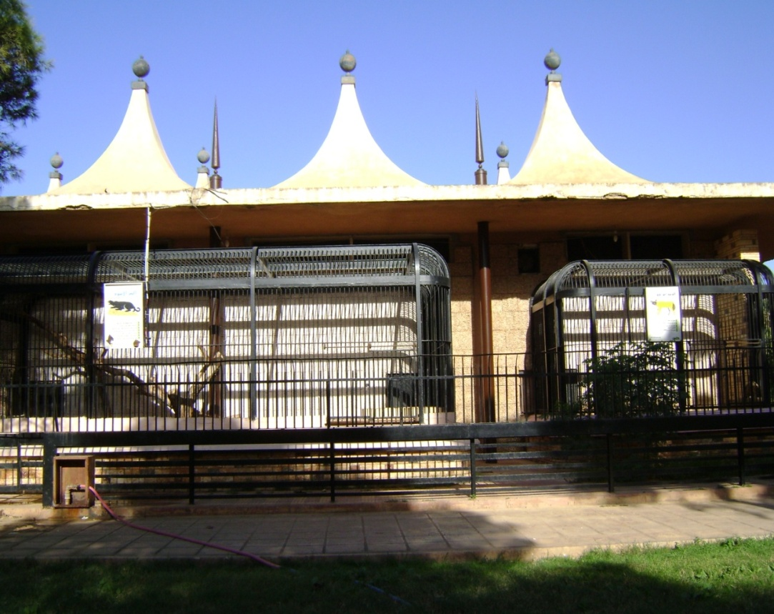
5) Development:

Slide 39
6)The relationship between the group of activities based on the movement density:

Slide 40
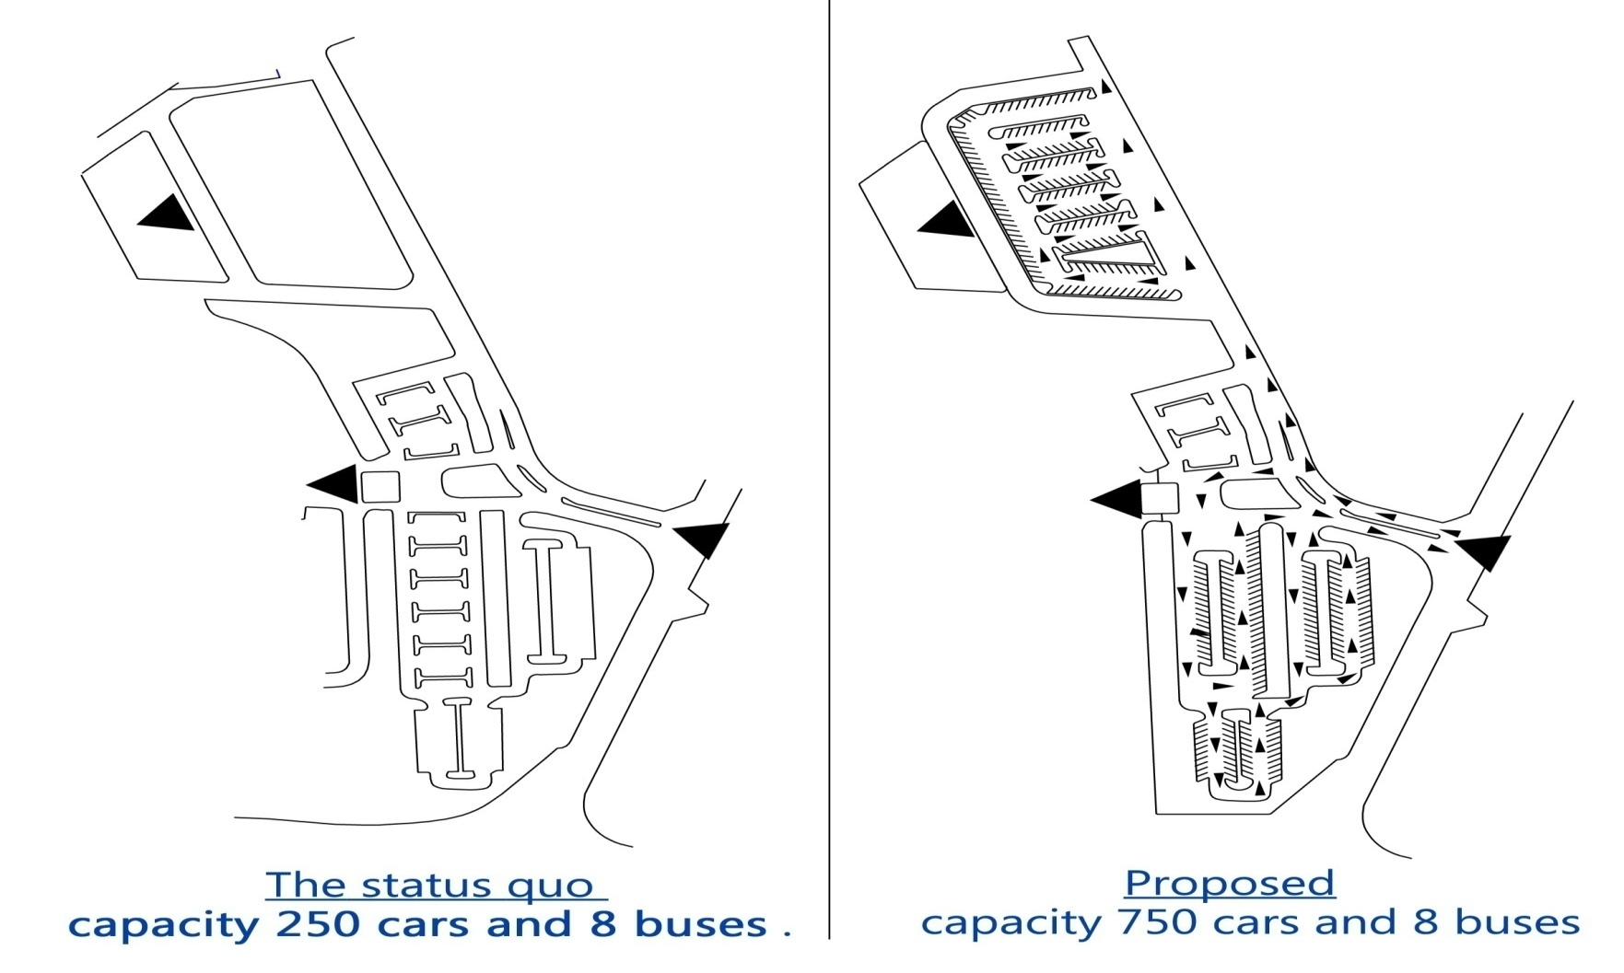
RECOMMENDATIONS
Proposed solutions to the parking problem.

Slide 41
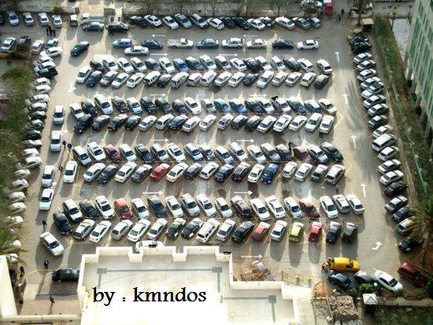


Slide 42
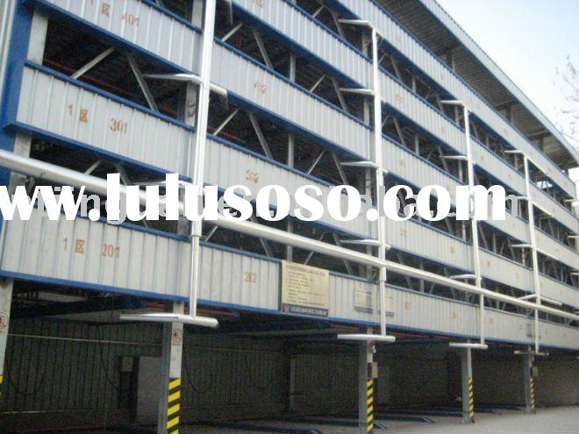

Slide 43
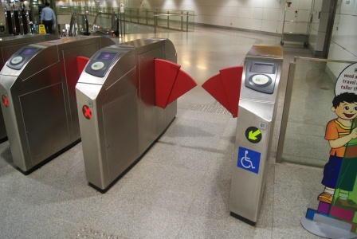
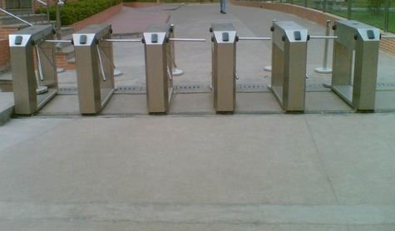
RECOMMENDATIONS
2) The best solution to the problem of congestion at the entrance to the park by using of smart gates.

Slide 44
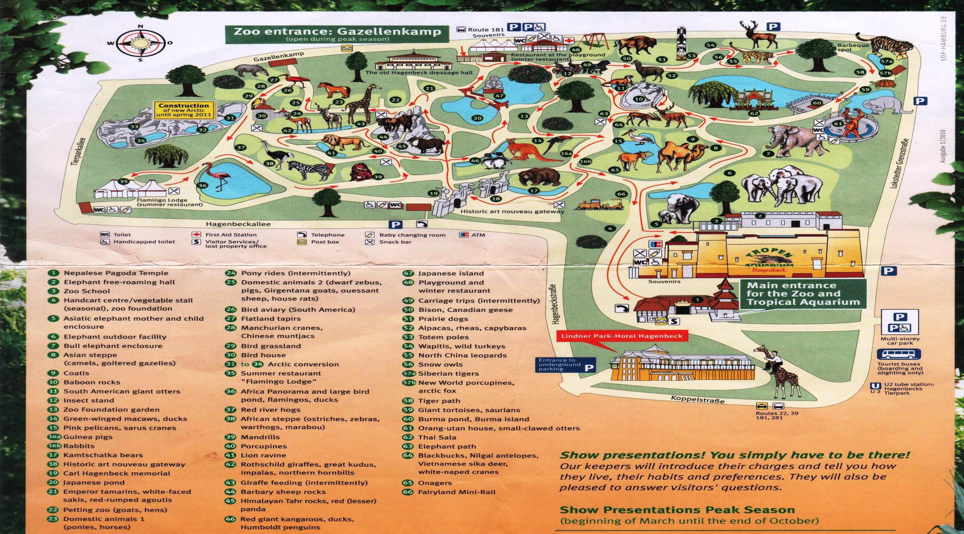
RECOMMENDATIONS
3) Suggest to delivering the customers the tour guide.

Slide 45
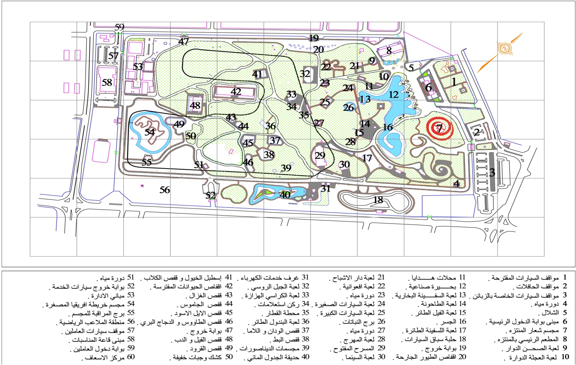
RECOMMENDATIONS
4)To reduce confusion inside the park by placed a large banner at the entrance to the park containing all inside activities and suggest to put directing signals after each certain distance.

Slide 46
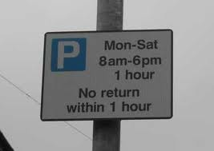
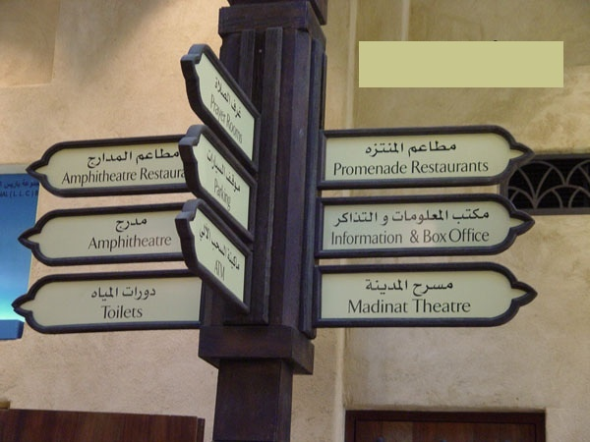
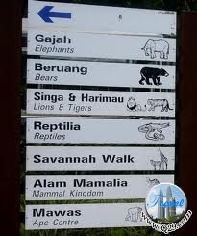

Slide 47
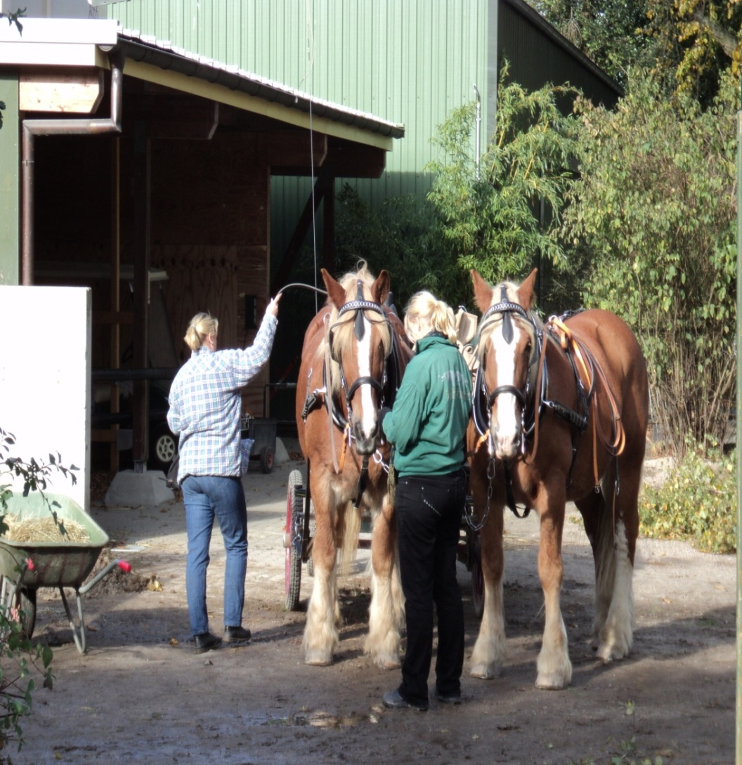
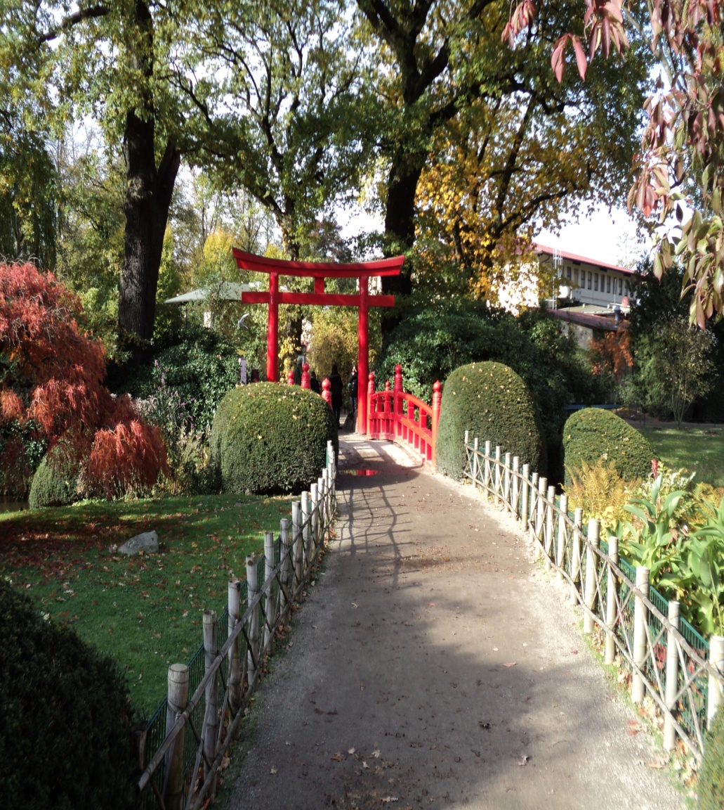
RECOMMENDATIONS
5)We recommend the management to monitor gardening team and veterinary team.

Slide 48
Animals
Group large animals
Bird group of animals
Group predators
Group
a pets
Climbing group of animals
Group domestic animals
Group of wild
6) Rearranging the sample that we referred to it in the third chapter, according to the allocated space to the zoo and the picture shows.

Slide 49
RECOMMENDATIONS
6) Rearranging the sample that we referred to it in the third chapter, according to the allocated space to the zoo and the picture shows.

Slide 50
1
INTRODUCTION
2
3
CASE STUDY AND ANALYSIS.
4
CONCLUSION AND RECOMMENDATIONS
LAYOUT AND FLOW.
5
OUR VISION AS INDUSTRIAL ENGINEERS

Slide 51
The proposed idea of the park
1) Classifying the year for four seasons according to the results. of the initial prediction of the most crowded to the list:
Red season (from 1/2/ to 30/4/ ) .
Orange season (from 1/5/ to 31/7/ ) .
Season yellow (from 1/8/ to 30/10/ ).
Blue season (from 1/11/ to 31/1/ ) .

Slide 52
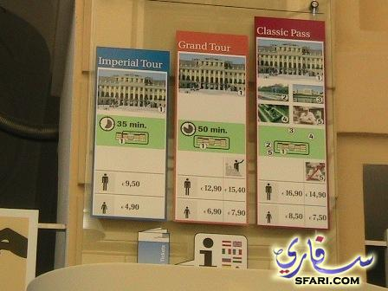
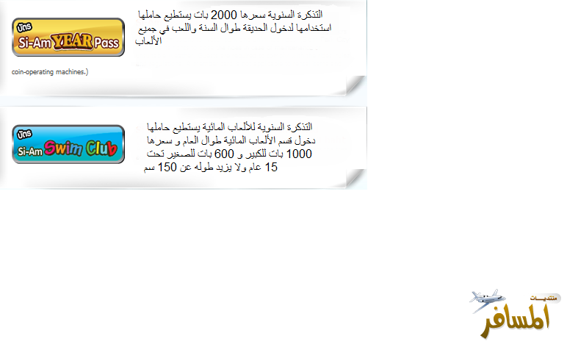
The proposed idea of the park

Slide 53
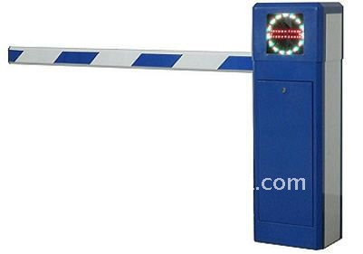
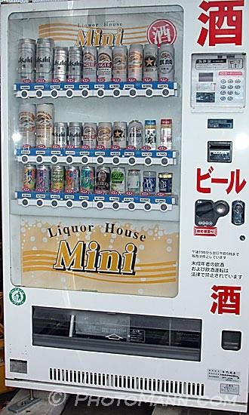
The proposed idea of the park

Slide 54
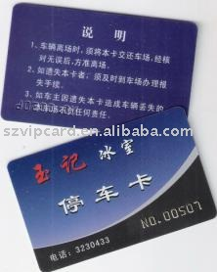
The proposed idea of the park

Slide 55
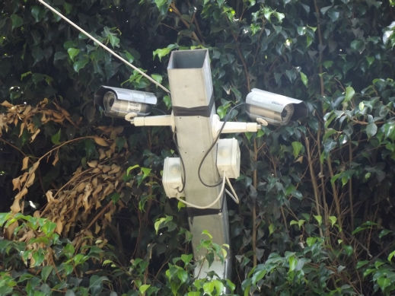
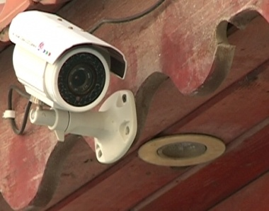
The proposed idea of the park

Slide 56
انتهى العرض
شكرا للحضور الكرام

